Slide 1
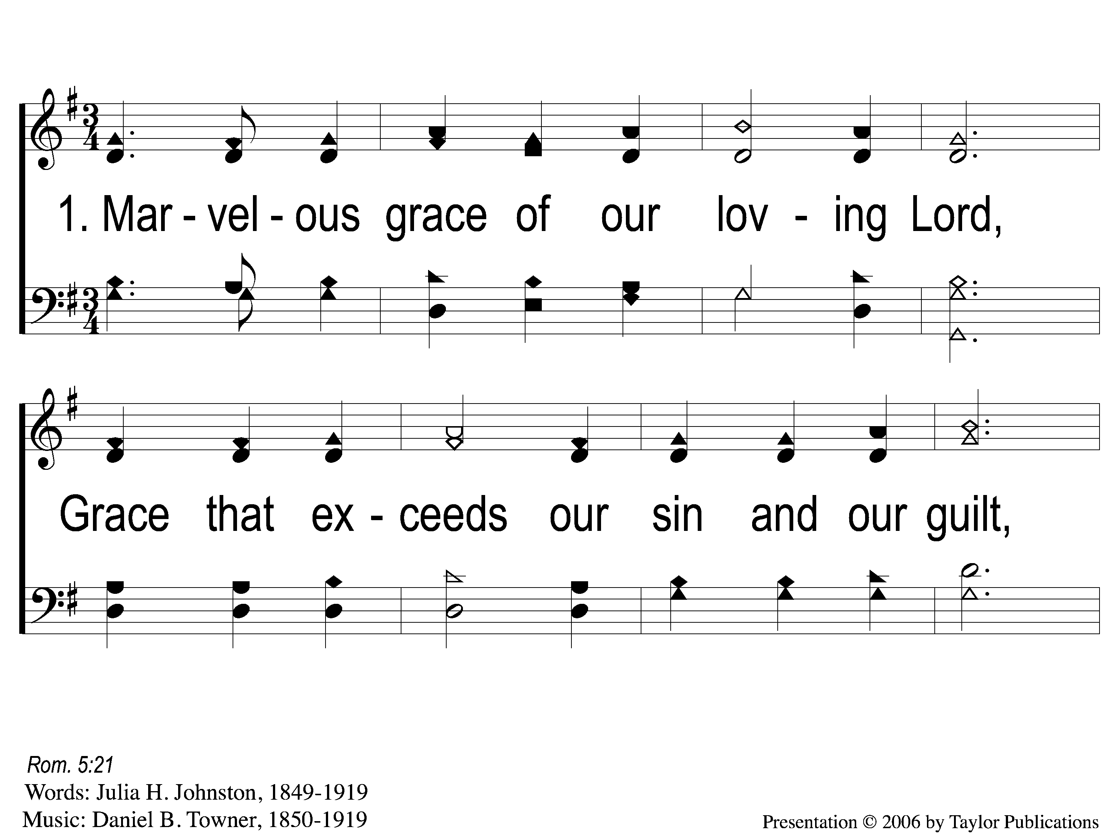
1-1 Grace Greater Than Our Sin
Grace Greater Than Our Sin
146

Slide 2
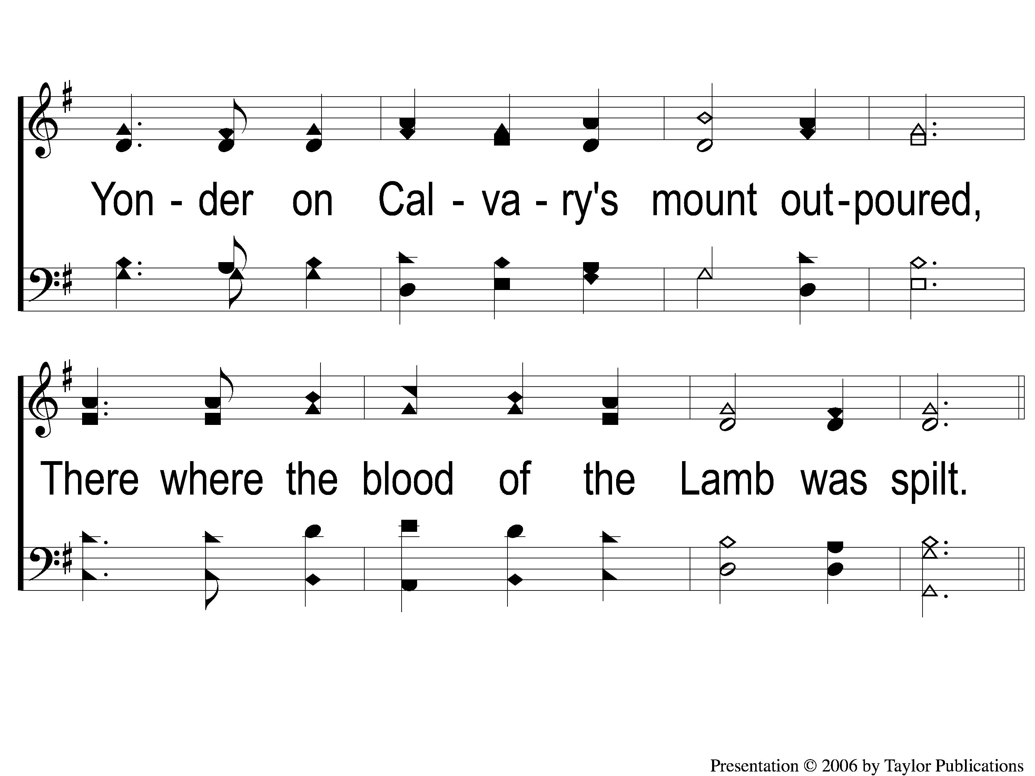
1-2 Grace Greater Than Our Sin
Grace Greater Than Our Sin
146

Slide 3
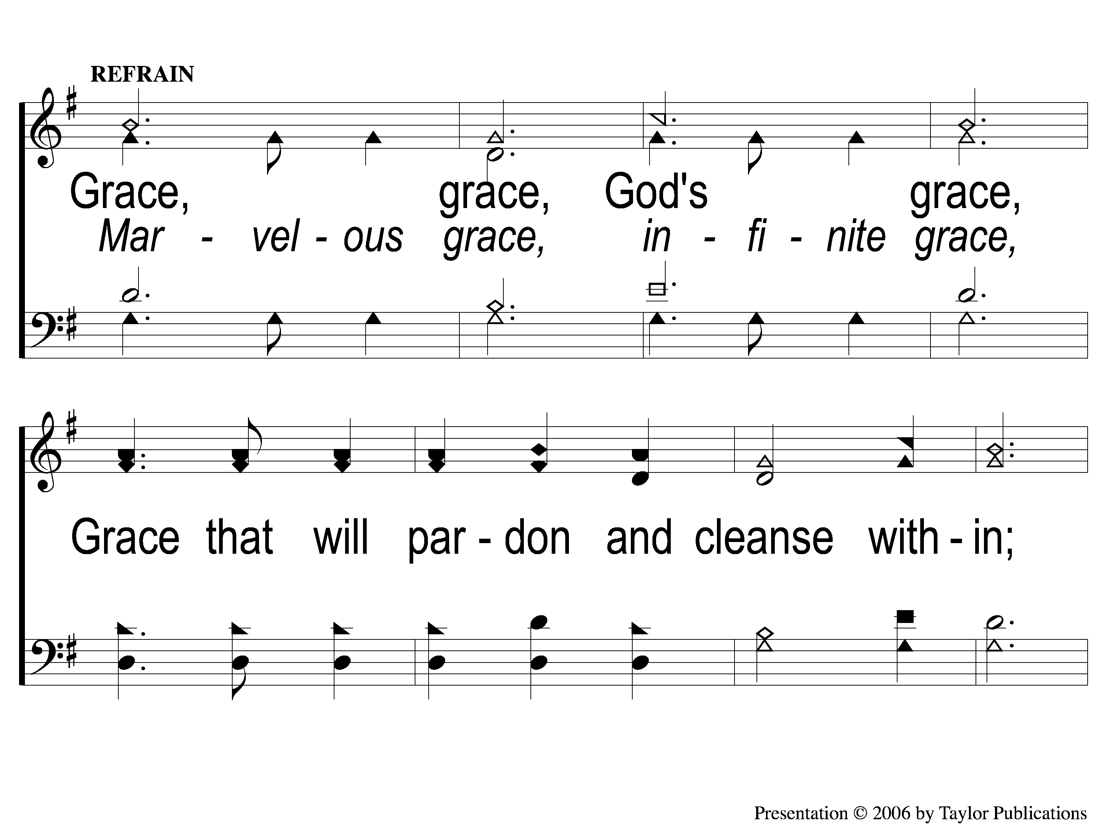
C-1 Grace Greater Than Our Sin
Grace Greater Than Our Sin
146

Slide 4
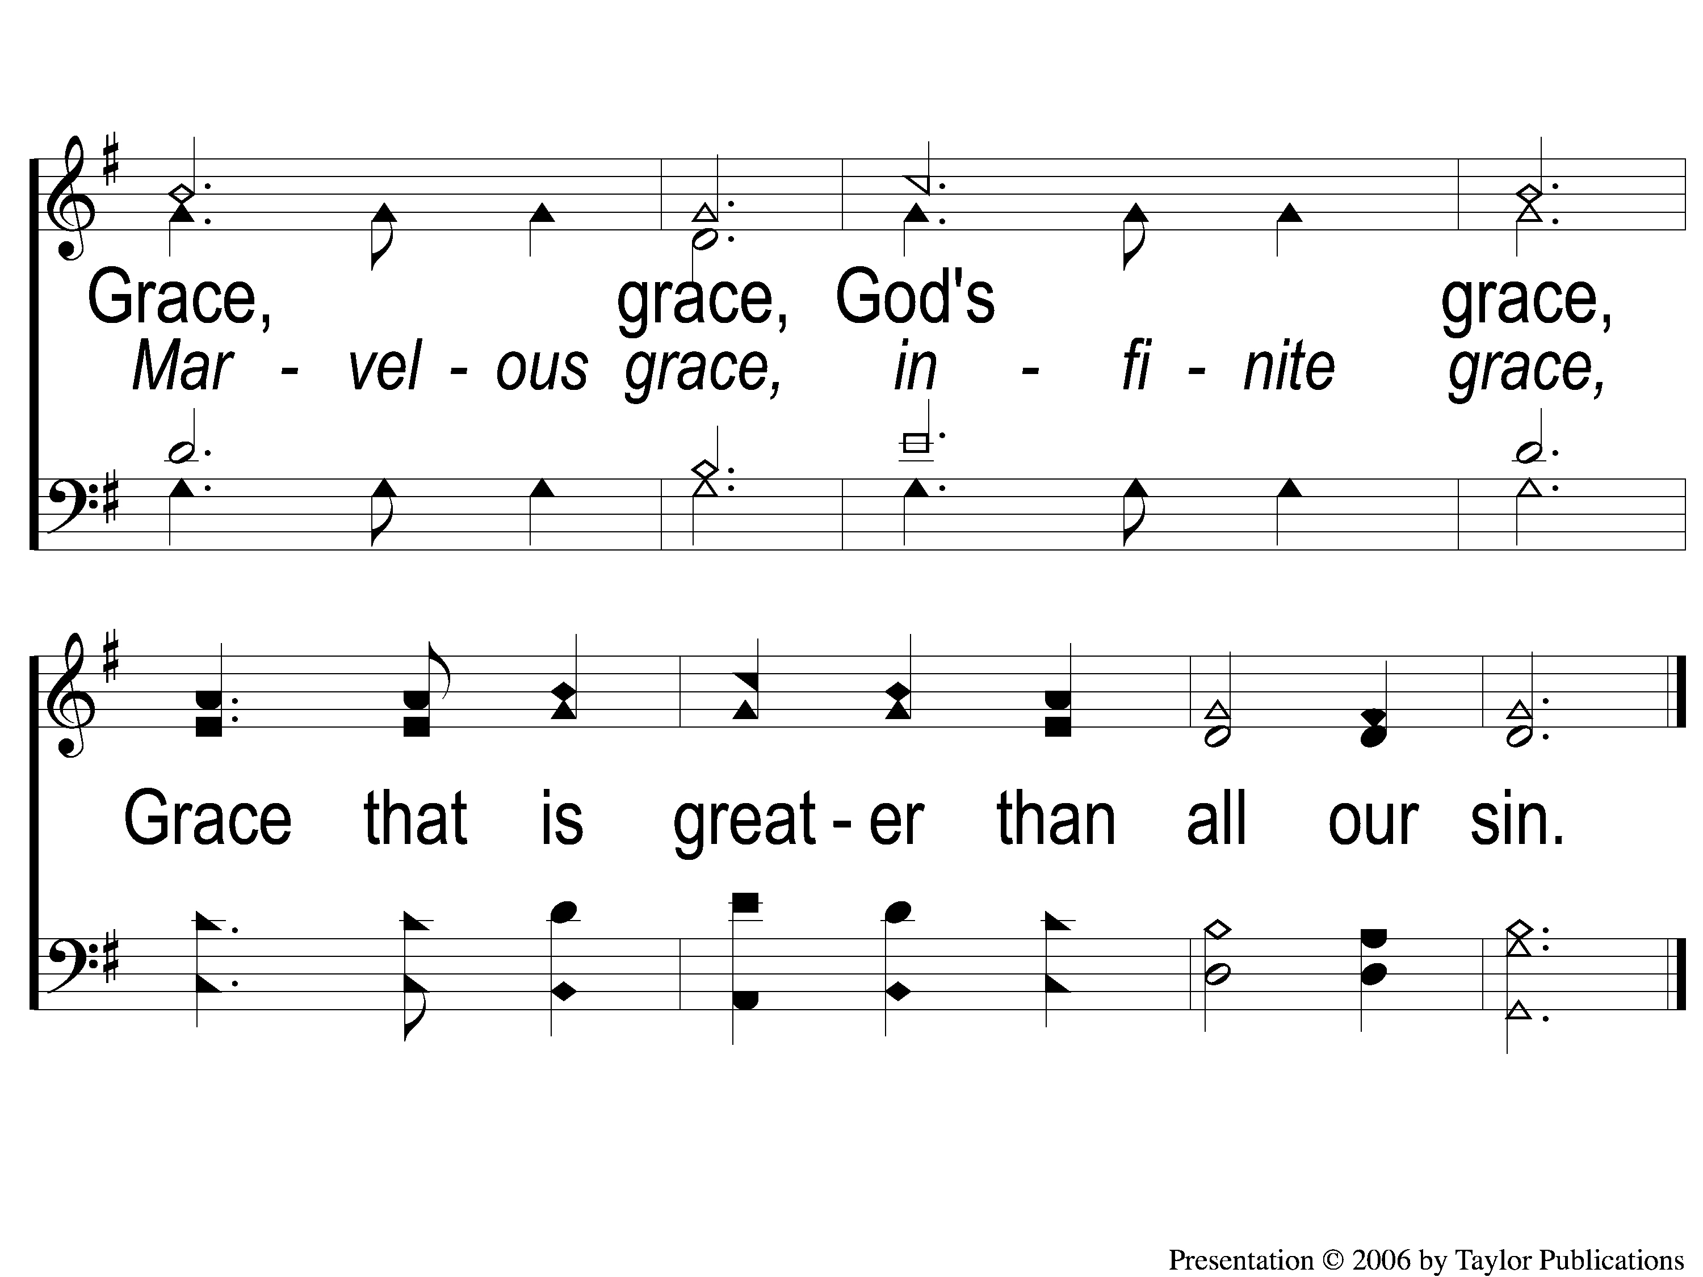
C-2 Grace Greater Than Our Sin
Grace Greater Than Our Sin
146

Slide 5
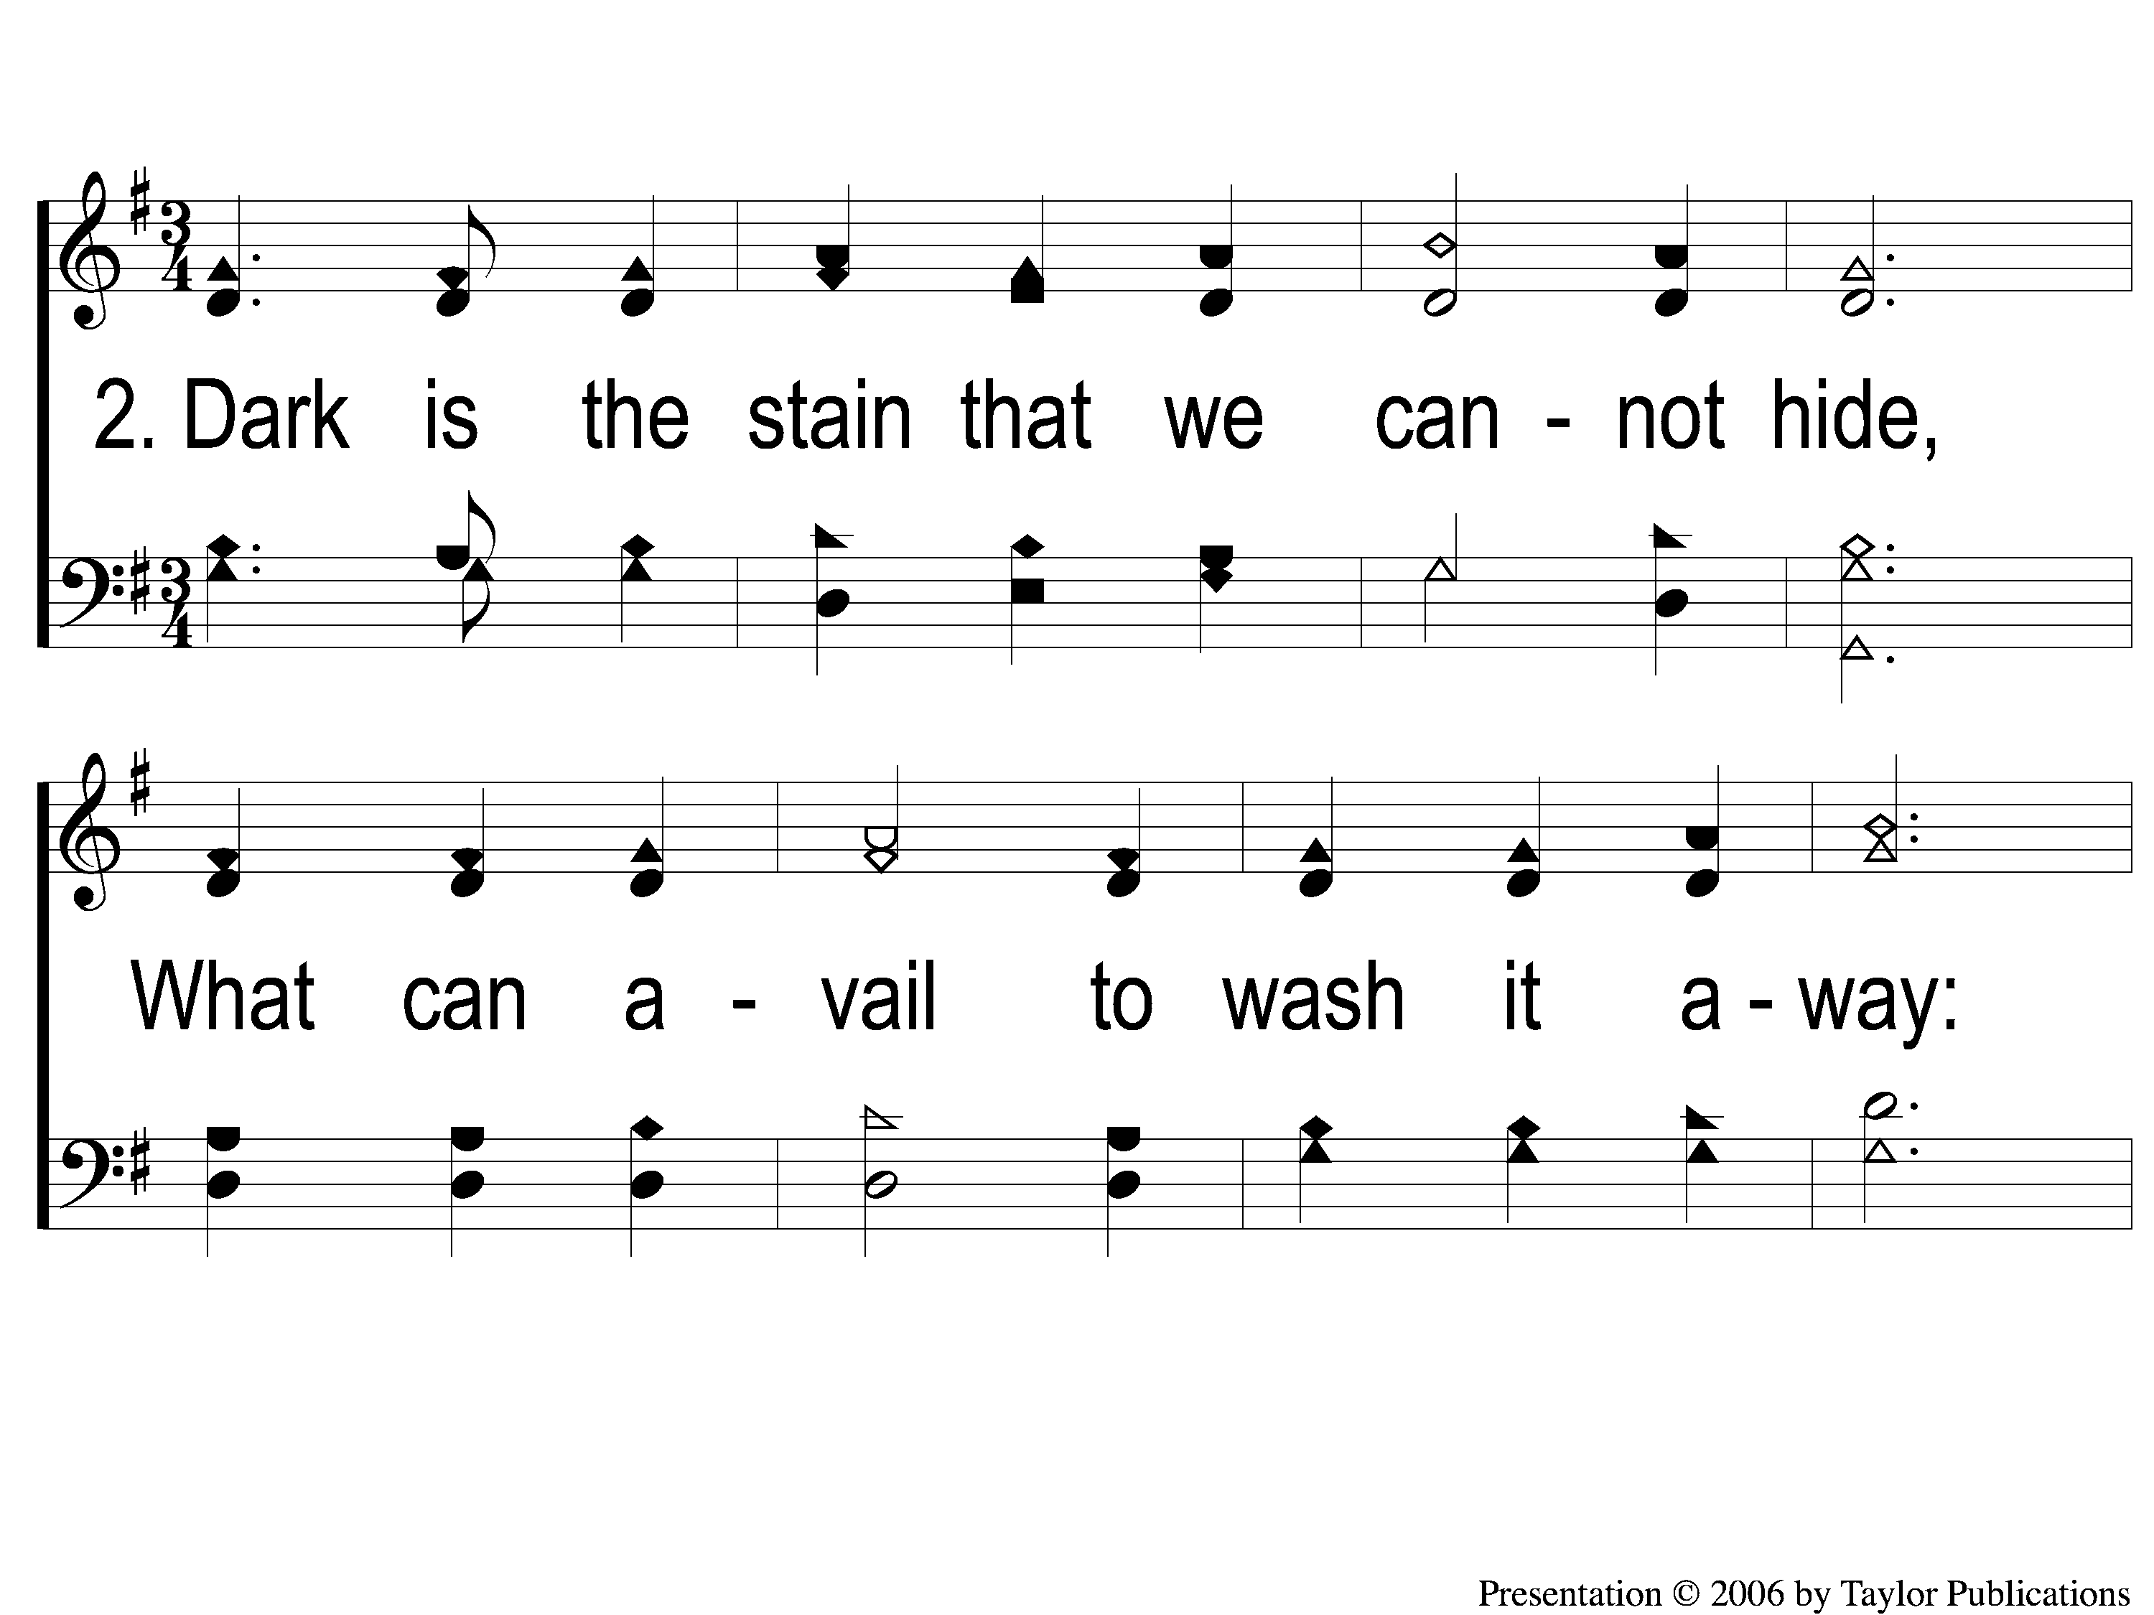
2-1 Grace Greater Than Our Sin
Grace Greater Than Our Sin
146

Slide 6
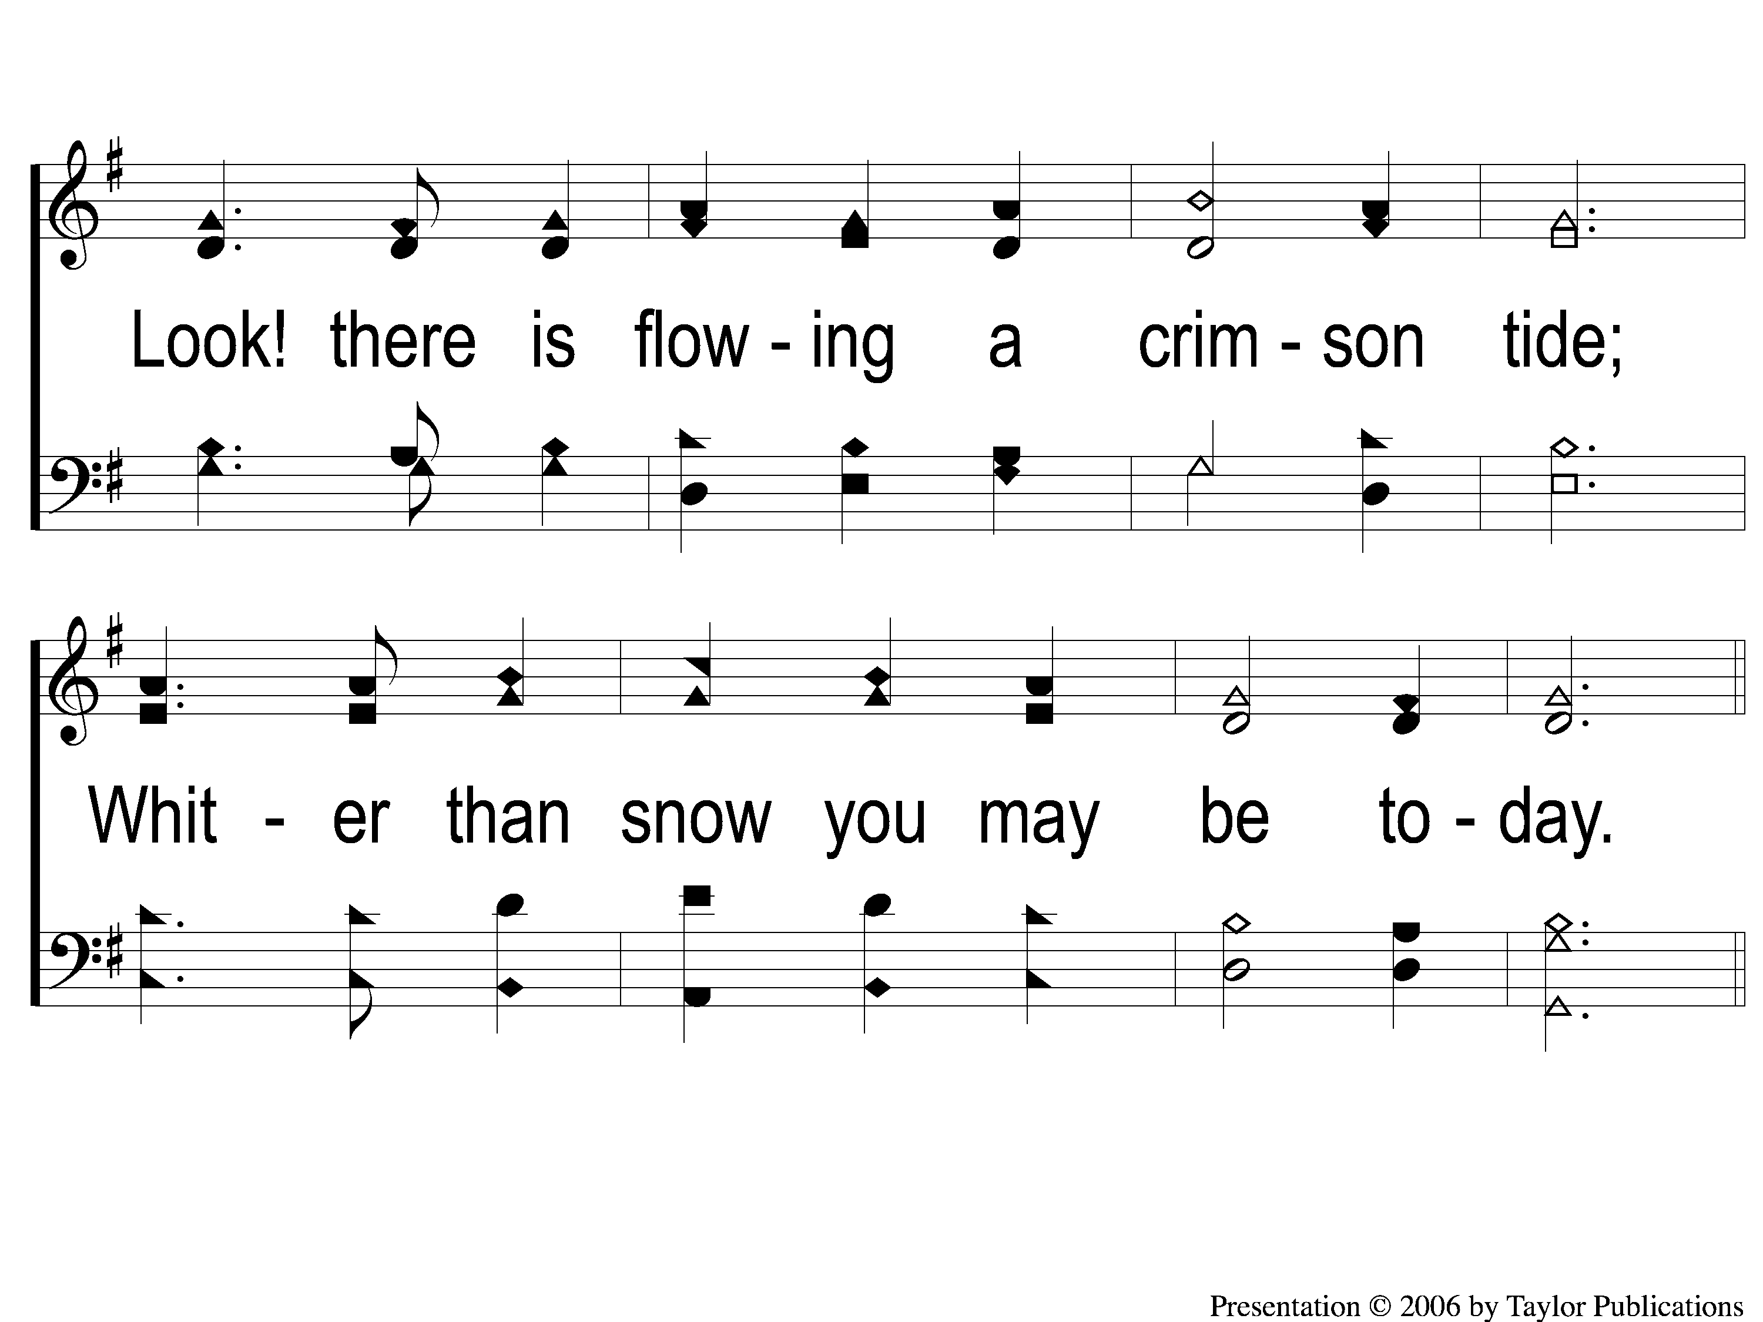
2-2 Grace Greater Than Our Sin
Grace Greater Than Our Sin
146

Slide 7
C-1 Grace Greater Than Our Sin
Grace Greater Than Our Sin
146

Slide 8
C-2 Grace Greater Than Our Sin
Grace Greater Than Our Sin
146

Slide 9
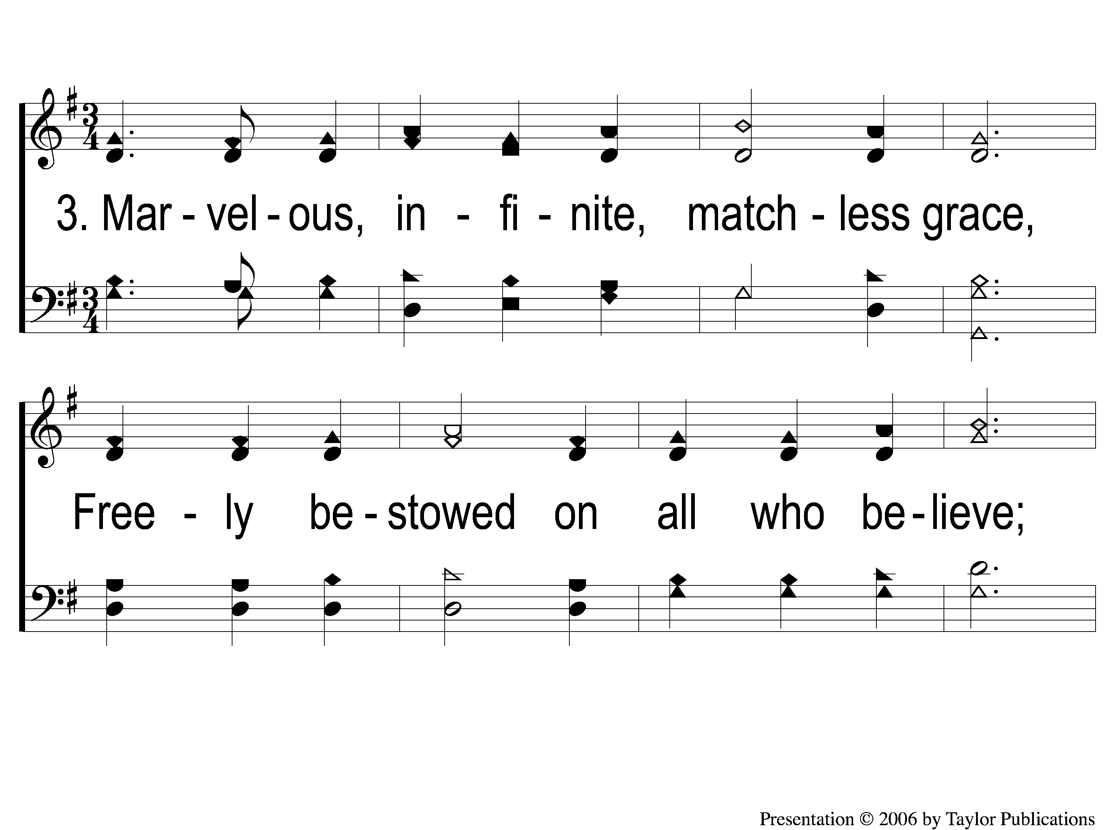
3-1 Grace Greater Than Our Sin
Grace Greater Than Our Sin
146

Slide 10
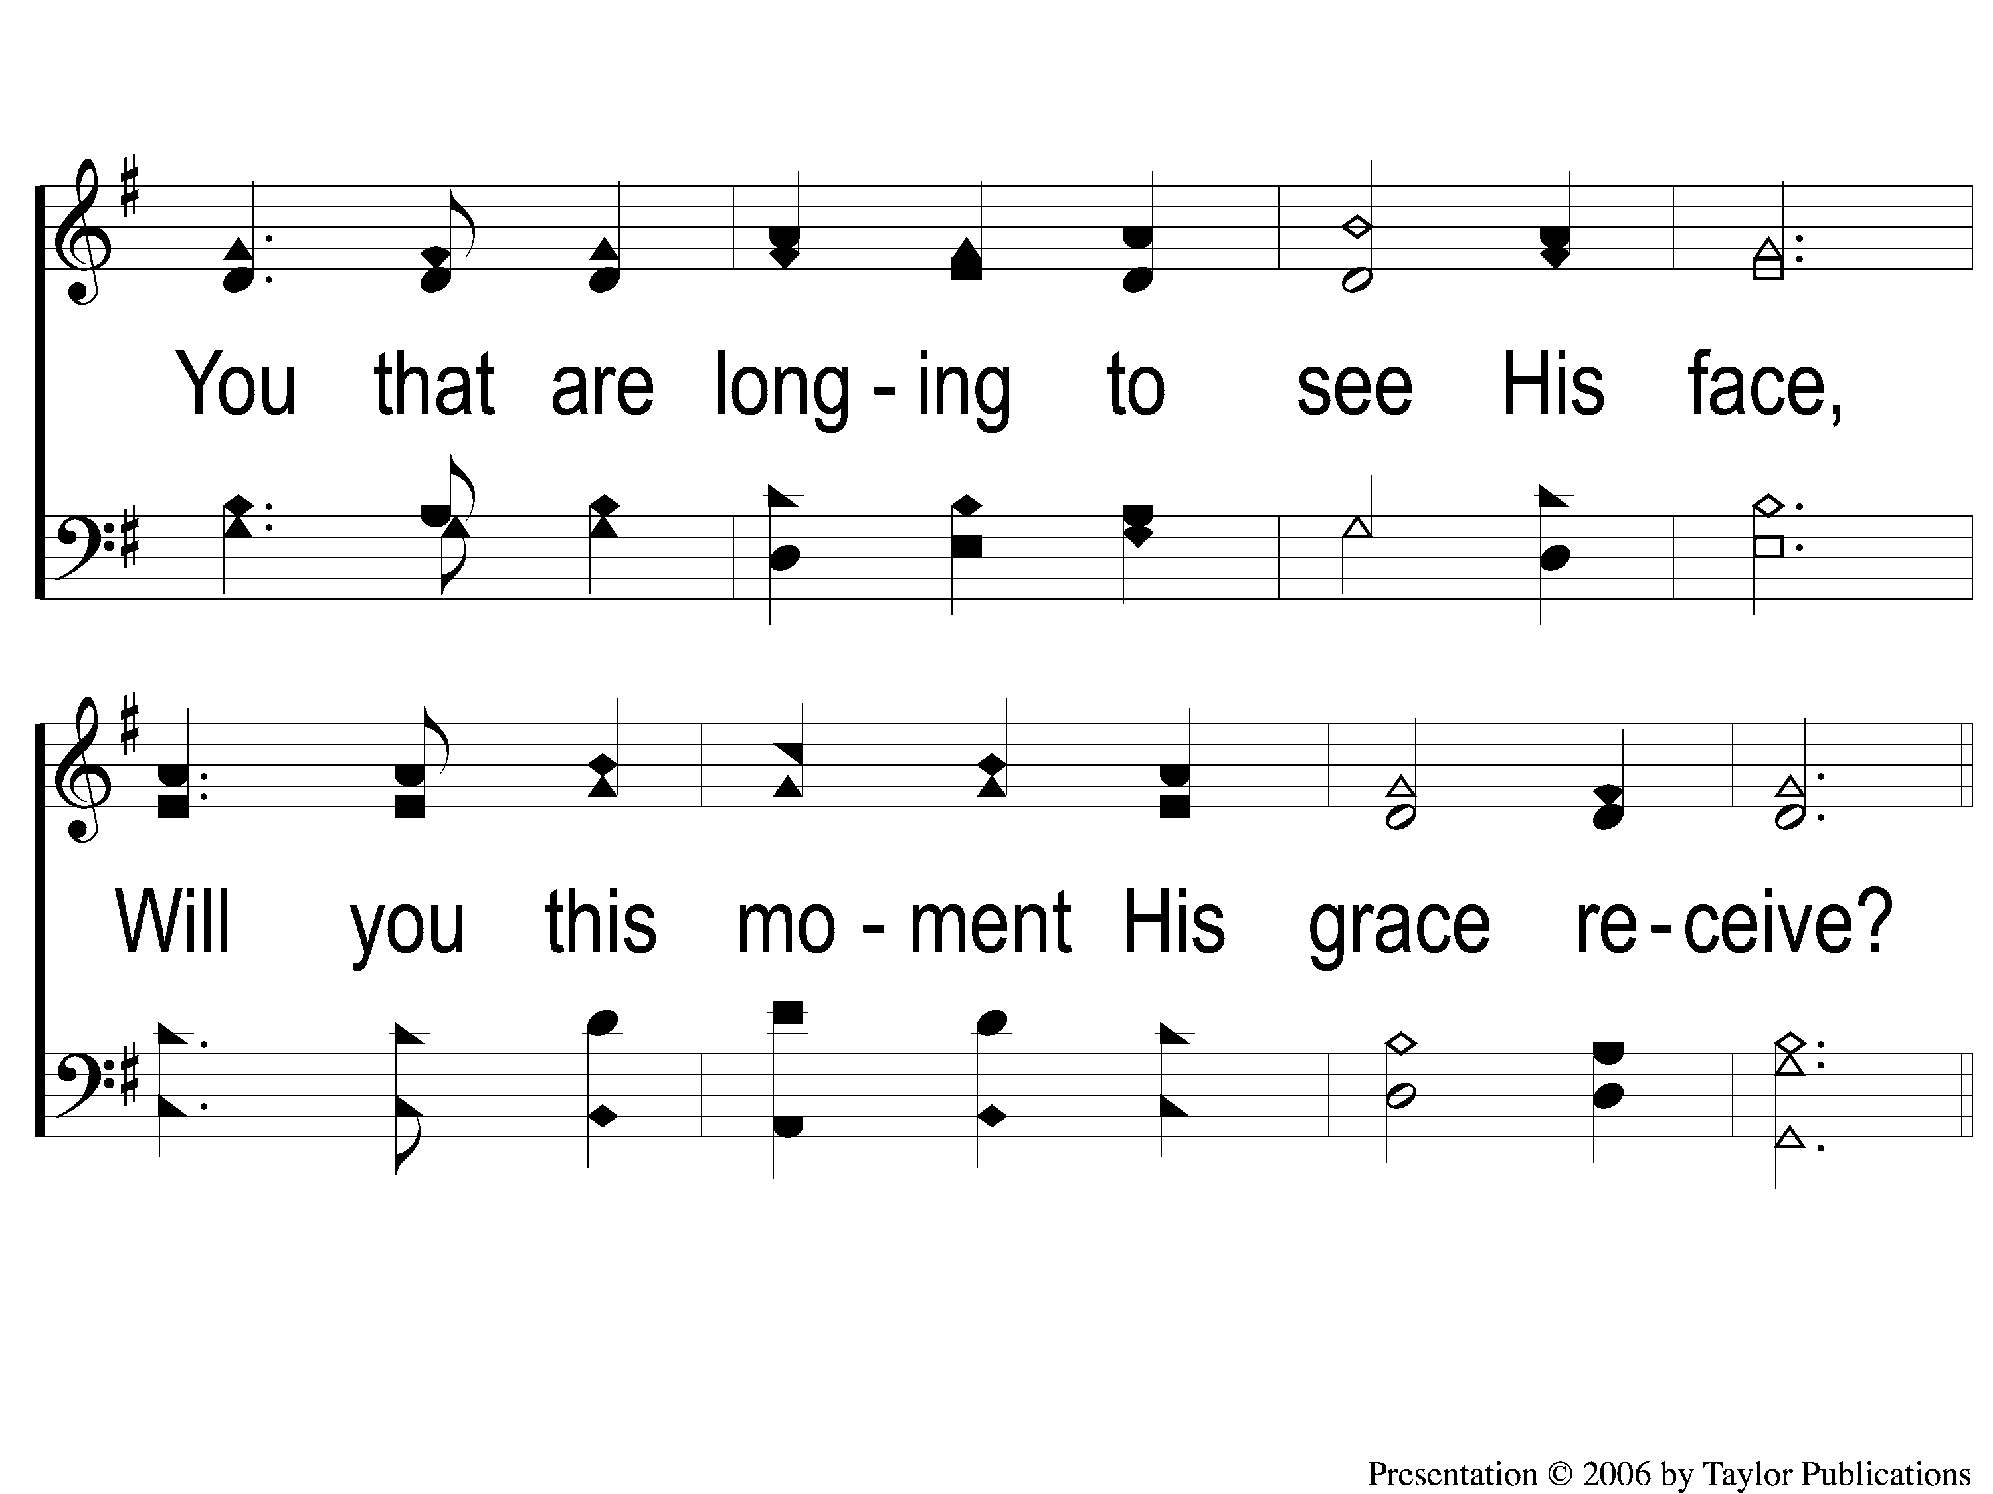
3-2 Grace Greater Than Our Sin
Grace Greater Than Our Sin
146

Slide 11
C-1 Grace Greater Than Our Sin
Grace Greater Than Our Sin
146

Slide 12
C-2 Grace Greater Than Our Sin
Grace Greater Than Our Sin
146

